Slide 1


NYC Job Salary Range Prediction
Presented by UTKARSH RAJ

Slide 2
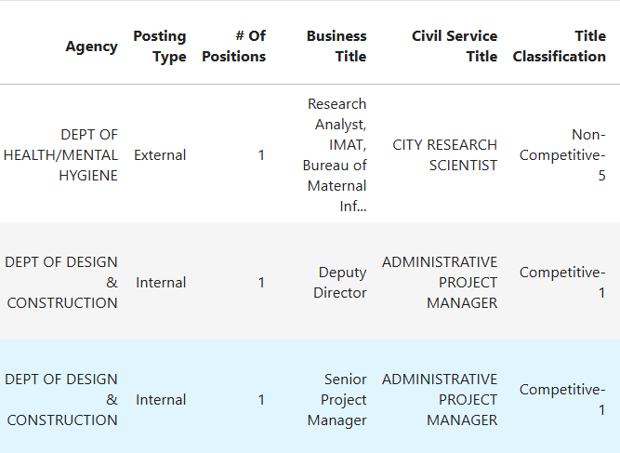
Hiring Challenges in NYC Public Sector
Core Problem: NYC posts 5,120+ diverse jobs yearly (e.g., agencies like Dept. of Correction 400+), but manual salary estimation is biased/inconsistent—e.g., $0–$252k ranges, high variability from 1,781 unique Business Titles.
Key Issues from Data: Skewed salaries (From mean $64.6k, To $90k; positive skew 0.59/0.37); missing data (e.g., 100% in Recruitment Contact); outliers (e.g., 150 positions max); imbalances (e.g., rare Job Categories <2 samples).
Business Pain Points: Delays in equitable budgeting/recruitment; bias risks (e.g., underpay in senior levels >$150k); 2025 hiring surges demand automation.
Opportunity: ML predicts ranges to cut errors 20–30%, enhance transparency (91% postings require "experience")

Slide 3
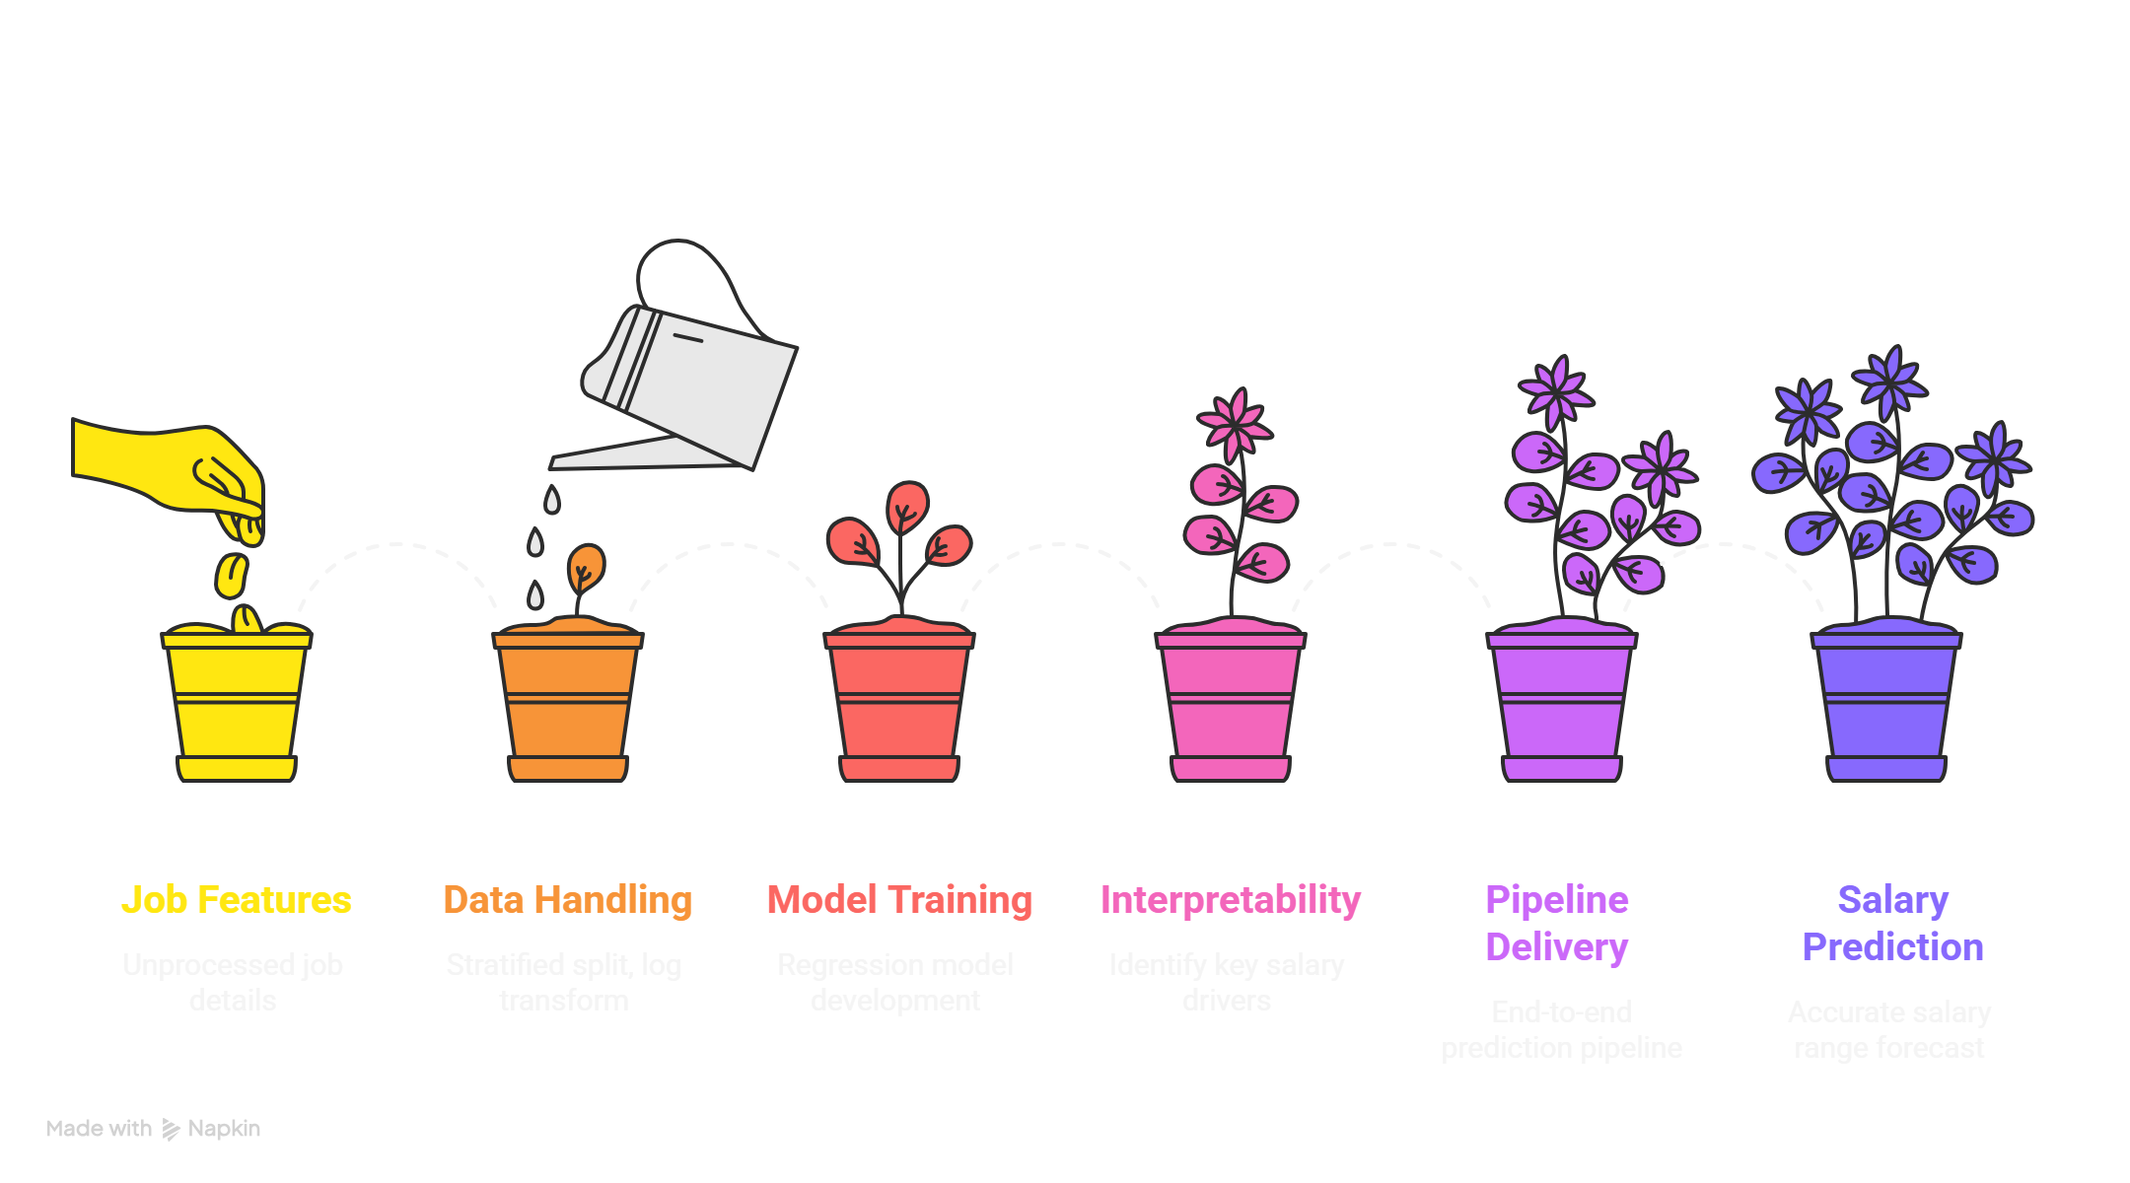
Project Objectives and Metrics

Slide 4
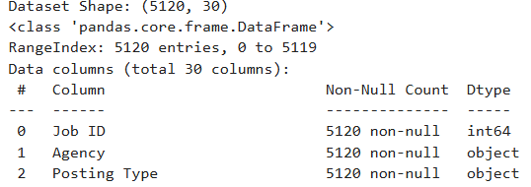
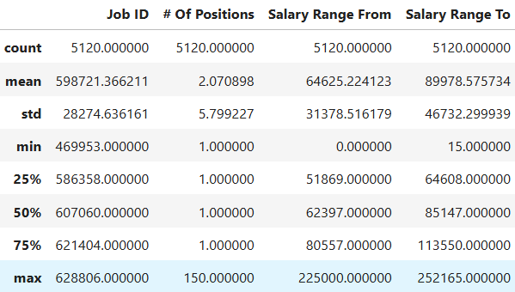
Dataset Summary
Source/Structure: NYC Jobs CSV (5120 rows, 30 cols → 28 post-drops); targets float64, categoricals object (e.g., Agency 59 unique).
Features Overview:
Numerical : Of Positions (mean 2.07, max 150), Posting Duration (mean 42.6 days), Age (785 days), text lengths (Job Desc 3521 chars mean).
Categorical : Business Title (1781 unique), Civil Service Title (365), Job Category (183), Work Location (293 → 7 boroughs), etc.
Targets: From ($0–$225k, skew 0.59, kurtosis 3.58); To ($15–$252k, skew 0.37, kurtosis 0.60); strong corr. 0.76.

Slide 5
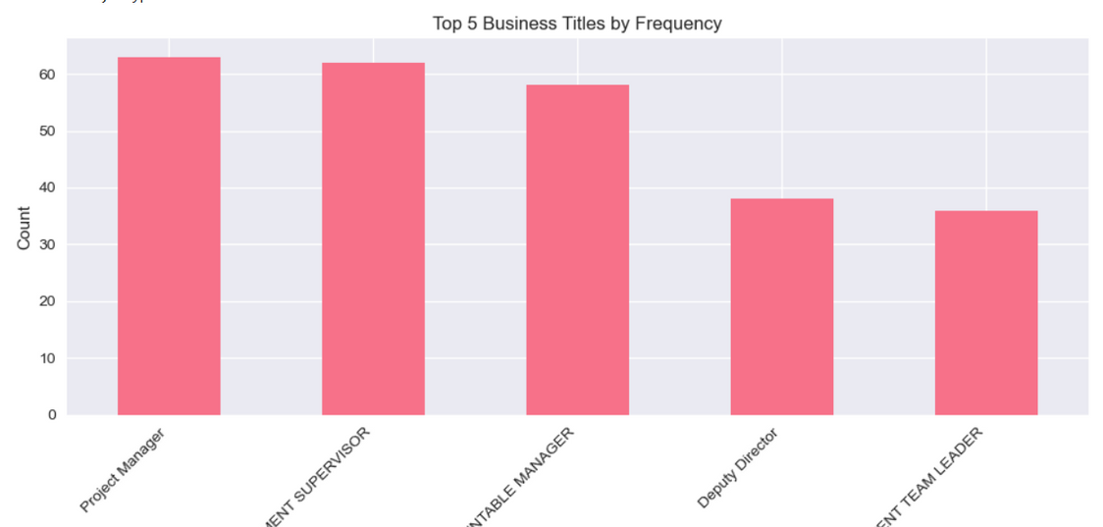
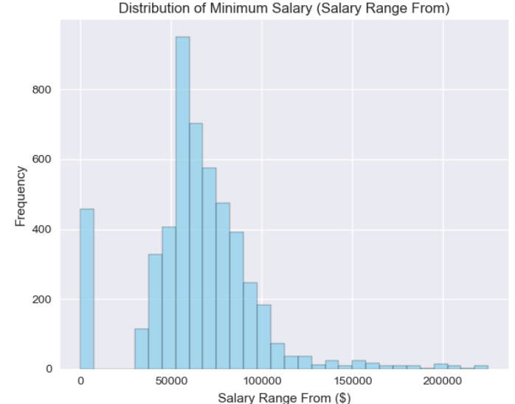
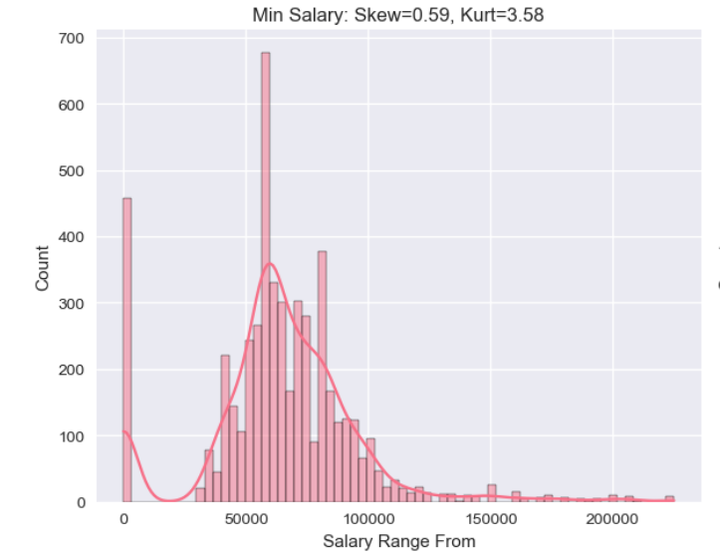
EDA - Univariate Distributions
Numerical Insights: Salaries right-skewed (histograms show tail >$150k); outliers in boxplots (e.g., From Q3 $80.6k, max $225k); Job ID uniform 469k–629k.
Categorical Highlights: Top Business Titles: Project Manager (63), Case Management Supervisor (62); Posting Type: External (majority); Career Level: Entry-Level dominant.
Targets Focus: From median $62.4k (kurtosis 3.58 → log needed); To median $85.1k; text lengths proxy complexity (Min Qual Req. 1077 chars mean).
Key Takeaway: Positive skew/outliers confirm log-transform; 91% require experience signals senior pay.

Slide 6
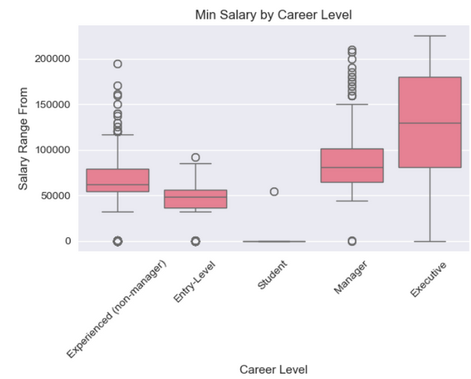
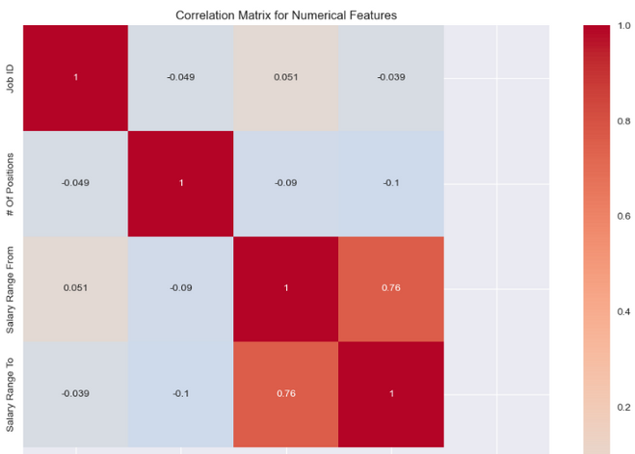
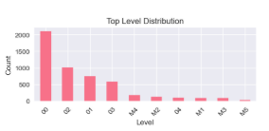
EDA - Bivariate Relationships
Salary vs. Career Level: Boxplots: Entry ~$43k–$54k, Experienced ~$64k–$87k, Manager ~$90k–$145k, Executive ~$131k–$187k, Student ~$83k–$126k (low count).
Correlations: Num heatmap: From-To r=0.76 (strong); weak others (e.g., Positions-From -0.09); no multicollinearity.
Categorical Patterns: Violin plots: Min salary higher for Internal postings; top agencies (DOC) skew high; Level (M2/M5) clusters mid-range.

Slide 7
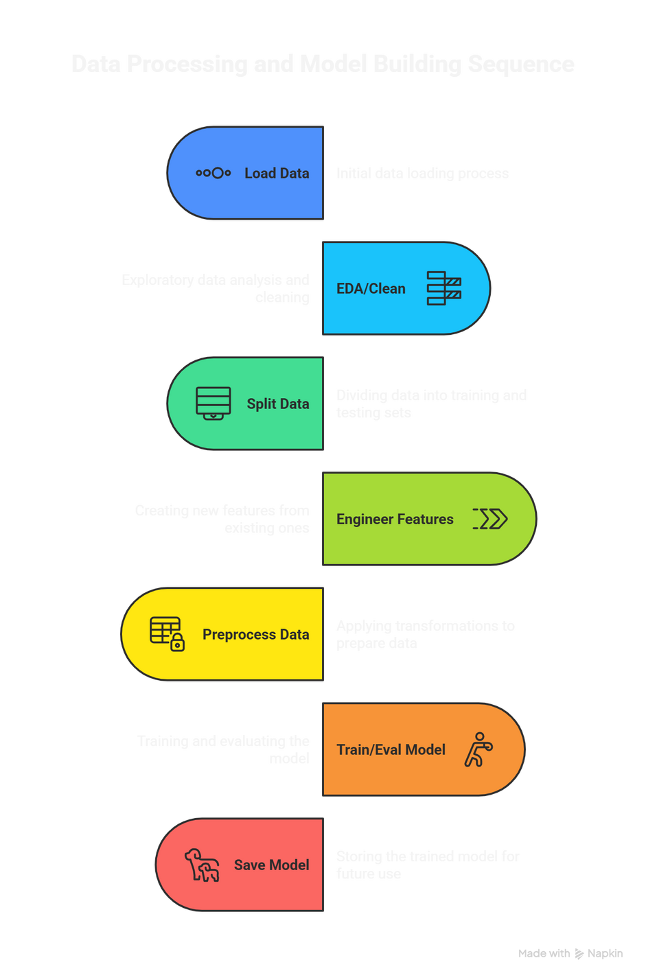
Pipeline Workflow
Preprocessing Details: 50 output features; RobustScaler nums (outliers); OneHot low-card (e.g., Career Level → 4 dummies); TargetEncoder high-card (fitted on 1D mean-log y proxy for multi-output).
Handling Challenges: Text dropped (use lengths: e.g., 3521 Job Desc chars); multi-y (2D) via separate fits; no NaN/Inf post-transform (Train 4096x50, Test 1024x50).
Tools: scikit-learn Pipeline, category_encoders, XGBoost; warnings ignored for clean runs.

Slide 8
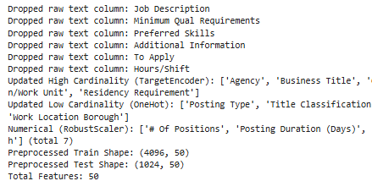
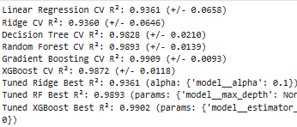
Models and Training
Approach: MultiOutputRegressor for joint From/To prediction (captures 0.76 corr.); 6 models tested on preprocessed data.
Baselines: LinearRegression (CV R² 93.6%), Ridge (93.6%).
Advanced: DecisionTree (CV 98.3%), RandomForest (98.9%), GradientBoosting (99.1%), XGBoost (98.%7)—ensembles for non-linear titles/locations.
Training: 5-fold CV on train; all fit ~10s full; predictions expm1 to original scale.

Slide 9
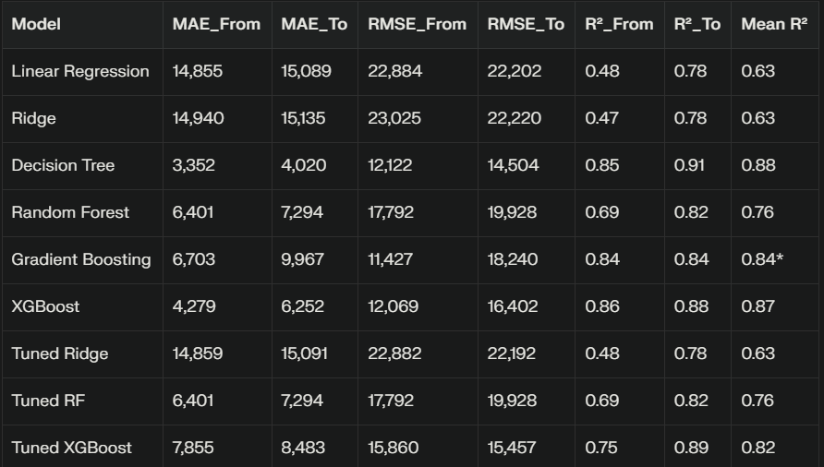
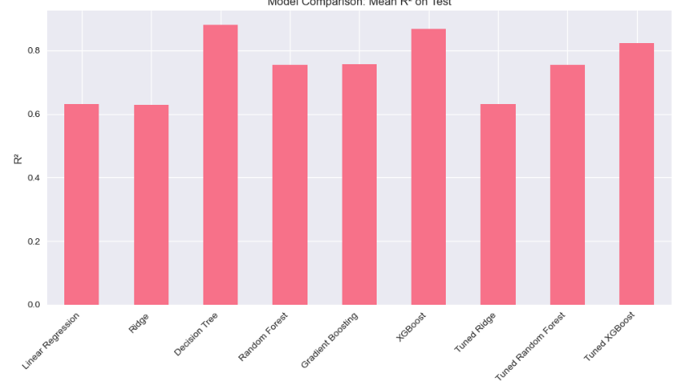
Performance Metrics
Test Set (1024 rows, Original Scale): Decision Tree best (Mean R² 88.08%); errors low for practical HR use.

Slide 10
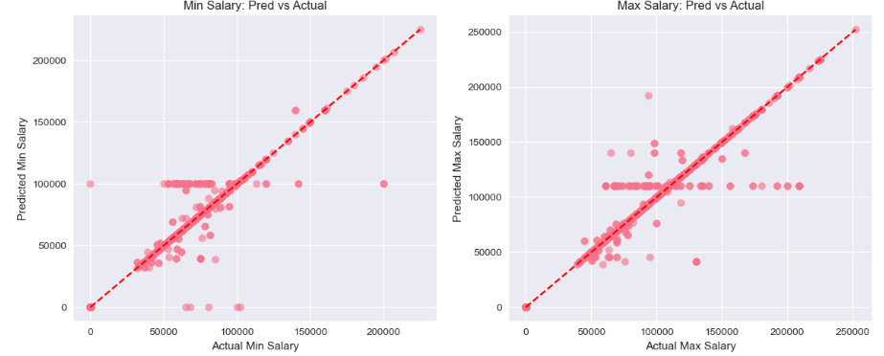
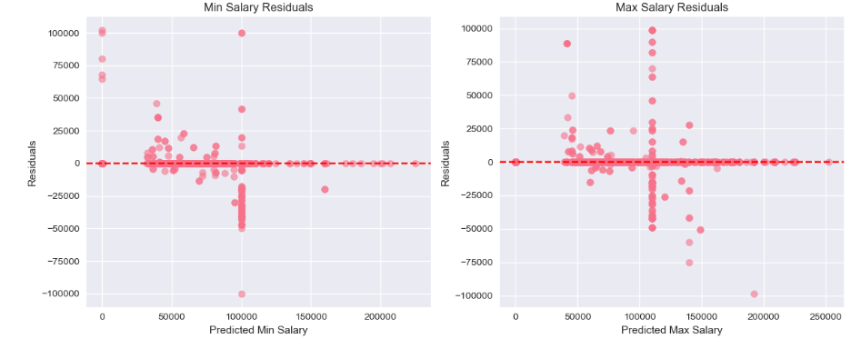
Results - Predictions and Residuals
Pred vs. Actual: Strong alignment (scatters near diagonal); R²_From 0.85, R²_To 0.91; minor underprediction <$30k Entry roles.
Residuals Analysis: Low bias overall (homoscedastic); slight heteroscedasticity high-end (>$150k seniors underpredicted ~$10k); no major agency disparities.

Slide 11
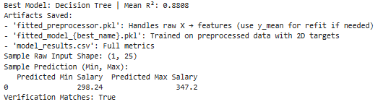
Model Selection, Artifacts, and Next Steps
Best Model: Decision Tree (Mean R² 88.08%; joint multi-output; simple/interpretable).
Artifacts Saved:
fitted_preprocessor.pkl: Raw X (28 cols) → 50 features (TargetEncoder on high-card w/ 1D y_mean).
fitted_model_decision_tree.pkl: Fits transformed X to 2D y.
predict_salary_range(raw_X): Wrapper loads → transform → predict (expm1) → DF (e.g., Min/Max cols); verifies matches.
Deployment: Ready for API/Excel; quarterly retrain (drift in postings).

Slide 12

Thank You
Reach out for Q&A
Email
Uraj757@gmail.com

